Slide 1
TDP, Stream it and Lambda it
May, 2017

Slide 2
Agenda
λ Expression
Stream API in a nut shell
Optional, remedy for NPE
Adoption in TDP 4

Slide 3

λ Expression
Anonymous function
Method without a declaration
Instance of a functional interface
Function is a first class citizen
Notes:
lambdas as an instance of an interface type

Slide 4
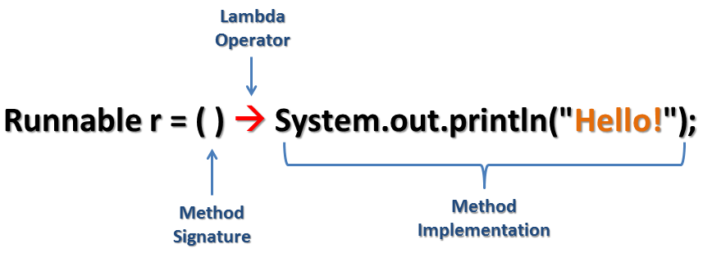
λ Expression
Notes:
lambdas as an instance of an interface type

Slide 5
λ Expression
(type1 arg1, type2 arg2...) -> { body }
(arg1, arg2...) -> { body }
Notes:
lambdas as an instance of an interface type

Slide 6
λ Expression Examples
(int a, int b) -> { return a + b; }
(a, b) -> { return a + b; }
(a, b) -> a + b
a -> return a*a
() -> System.out.println("Hello World");
(String s) -> { System.out.println(s); }
() -> { return 3.1415;}
() -> 42

Slide 7
λ Expression
List<String> names = Arrays.asList("peter", "anna", "mike", "luna", "jacob", "angela");
// java 7 code for (String name : names) System.out.println(name);
// java 8 code with lambda names.forEach((String name) -> System.out.println(name));

Slide 8
λ Expression under the hood
An instance of an interface
// java 8 code with forEach names.forEach(new Consumer<String>() { @Override public void accept(String name) { System.out.println(name); } });

Slide 9
Final or Effectively Final
For both lambda bodies and inner classes, local variables in the enclosing context can only be referenced if they are final or effectively final.
A variable is effectively final if it is never assigned to after its initialization.
No longer need to litter code with final keyword

Slide 10
Final or Effectively Final
int zero = 0; List<Person> sortedPersons = persons.stream() .sorted((p1, p2) -> (p1.getAge() - p2.getAge() > zero ? 1 : -1)) .collect(Collectors.toList());
Effective final
int zero = 0; zero = 0; List<Person> sortedPersons = persons.stream() .sorted((p1, p2) -> (p1.getAge() - p2.getAge() > zero ? 1 : -1)) .collect(Collectors.toList());
Non effective final,compile error incur
Error:(43, 66) java: local variables referenced from a lambda expression must be final or effectively final

Slide 11
Functional Interface
Functional Interface @FunctionalInterface
Single Abstract Method (SMA) interface
Could have default method with implementation

Slide 12
Functional Interface
Examples in J2SE API?
Runnable
Callable
Comparator
Consumer
Predicate

Slide 13
λ Expression In Runnable
Runnable runnable1 = new Runnable() { @Override public void run() { System.out.println("Hello Lambda"); } }; new Thread(runnable1).start(); Runnable runnable2 = () -> System.out.println("Hello Lambda"); new Thread(runnable2).start();
Notes:
Put java 7 and java 8 version vertically

Slide 14
λ Expression In Comparator
Collections.sort(names, new Comparator<String>() { @Override public int compare(String a, String b) { return b.compareTo(a); } }); Collections.sort(names, (String a, String b) -> { return b.compareTo(a); }); Collections.sort(names, (String a, String b) -> b.compareTo(a)); Collections.sort(names, (a, b) -> b.compareTo(a)); Collections.sort(names, Comparator.reverseOrder());

Slide 15
λ Expression In Consumer
// java 8 code with lambda names.forEach((String name) -> System.out.println(name)); // java 8 code with lambda names.forEach(name -> System.out.println(name)); // java 8 code with method reference names.forEach(System.out::println);

Slide 16
Method Reference
A method reference is used to refer to a (static or instance) method without invoking it
A constructor reference is similarly used to refer to a constructor without creating a new instance of the named class or array type.
Specified with the :: (double colon) operator
Brief and clearly expressive way to implement functional interfaces

Slide 17
Method Reference Types
Type | Format
Reference to a static method | ContainingClass::staticMethodName
Reference to an instance method of a particular object | containingObject::instanceMethodName
Reference to an instance method of an arbitrary object of a particular type | ContainingType::methodName
Reference to a constructor | ClassName::new

Slide 18
Method Reference Examples
Type | Example
Reference to a static method | System.out::println
Reference to an instance method of a particular object | "abc"::length
Reference to an instance method of an arbitrary object of a particular type | String[] stringArray = { "Barbara", "James", "Mary"}; Arrays.sort(stringArray, String::compareToIgnoreCase);
Reference to a constructor | ArrayList::new

Slide 19
Default Method
added for backward compatible
old interfaces can be used to leverage the lambda expression capability
‘Iterable’
forEach
‘Collection’
removeIf
stream
parallelStream

Slide 20
Multiple Defaults
interface Vehicle { default void print(){ System.out.println("I am a vehicle!"); } } interface FourWheeler { default void print(){ System.out.println("I am a four wheeler!"); } }

Slide 21
Multiple Defaults
class Car implements Vehicle, FourWheeler { public void print(){ Vehicle.super.print(); } }
class Car implements Vehicle, FourWheeler { public void print(){ System.out.println("I am a vehicle and four wheeler!"); } }

Slide 22

Stream

Slide 23
What is Stream
SQL-Like Operation
Declarative
Lazy evaluation
Promote immutability
Easier parallelization
Clean and concise code

Slide 24
Question?
Given a collection of Transactions : List<Transaction> transactions
Find out all transactions of type grocery
Sort them in decreasing order of transaction value
Return a list of transaction IDs : List<Integer> transactionIds

Slide 25
Solution before Java 8
// find the GROCERY type for(Transaction t: transactions){ if(t.getType() == TransactionType.GROCERY){ groceryTransactions.add(t); } }
// sort by value in descending order Collections.sort(groceryTransactions, new Comparator<Transaction>() { @Override public int compare(Transaction t1, Transaction t2) { return t2.getValue().compareTo(t1.getValue()); } });
// add to another List of Integer List<Integer> transactionIds = new ArrayList<>(); for(Transaction t: groceryTransactions){ transactionIds.add(t.getId()); }

Slide 26
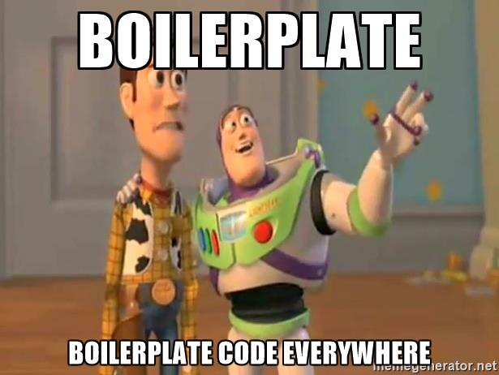
Boilerplate Code
Notes:
In my opinion Java 8 code is better because of following reasons:
Java 8 code clearly reflects developer intent of filtering, sorting, etc.
Developers express what they want to do rather than how they want do it by using a higher level abstraction in the form of the Stream API.
The Stream API provides a unified language for data processing. Now developers will have a common vocabulary when talking about data processing. When two developers talk about a filter function, you can be sure that they both are applying a data filtering operation.
No boilerplate code is required to express data processing. Developers no longer have to write explicit for loops, or create temporary collections to store data. All is taken care by the Stream API itself.
Streams do not modify your underlying collection - they are non-mutating.

Slide 27
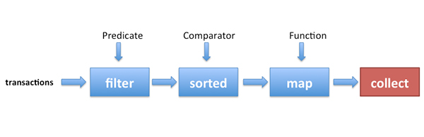
Solution with Stream
List<Integer> transactionsIds = transactions.stream() .filter(t -> t.getType() == TransactionType.GROCERY) .sorted(comparing(Transaction::getValue).reversed()) .map(Transaction::getId) .collect(toList());

Slide 28
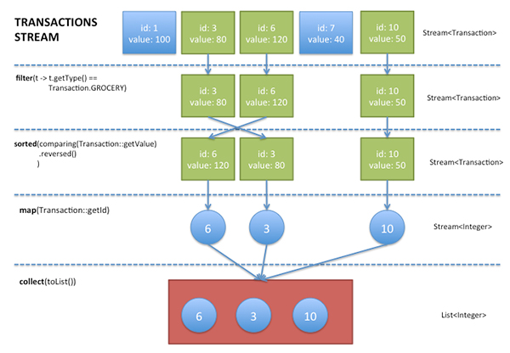
Stream
Notes:
a sequence of elements from a source that supports aggregate operations.” Streams consume from a source such as collections, arrays, or I/O resources. Streams support the common operations from functional programing languages, such as map, filter, reduce, find, sorted, etc

Slide 29
How to understand Stream
Source
Sequence of elements, arrays, collection, list, set
Flow
Intermediate operation
Aggregate operation
Pipelining
Internal iteration
Lazy evaluation
Sink
Final operation
Make the computation happen
Boss

Slide 30
Method Pipelining
Unix-like command pipelining
A pipeline is a sequence of processes
Chained together by their standard streams
Output of each process (stdout) feeds directly as input (stdin) to the next one
Each process is doing one job, and it is doing it really good
ls -l | grep key | less
ls –l | grep key | wc -l

Slide 31
Assembly Line
Notes:
a sequence of elements from a source that supports aggregate operations.” Streams consume from a source such as collections, arrays, or I/O resources. Streams support the common operations from functional programing languages, such as map, filter, reduce, find, sorted, etc

Slide 32
Stream Operations
An intermediate operation keeps a stream open for further operations. Intermediate operations are lazy.
A terminal operation must be the final operation on a stream. Once a terminal operation is invoked, the stream is consumed and is no longer usable.

Slide 33
Intermediate Operations
filter excludes all elements that don’t match a Predicate.
map performs a one-to-one transformation of elements using a Function.
sorted sort all the elements according to a the Comparable implementation of the element type or according to a Comparator

Slide 34
Terminal Operation
forEach performs an action for each element of this stream
collect performs a mutable reduction operation on the elements of this stream using a Collector
reduce performs a reduction on the elements of this stream, using the provided identity value and an associative accumulation function, and returns the reduced value

Slide 35
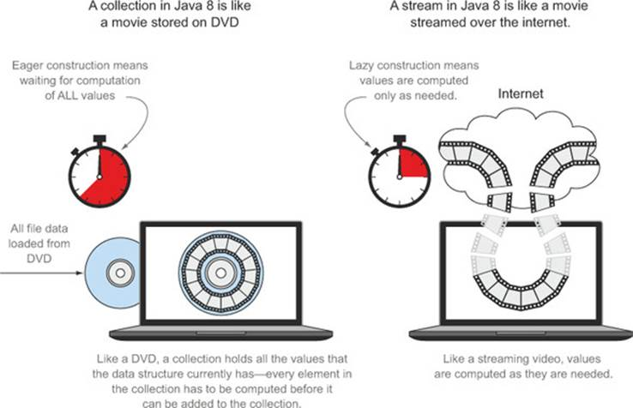
Stream vs Collection

Slide 36
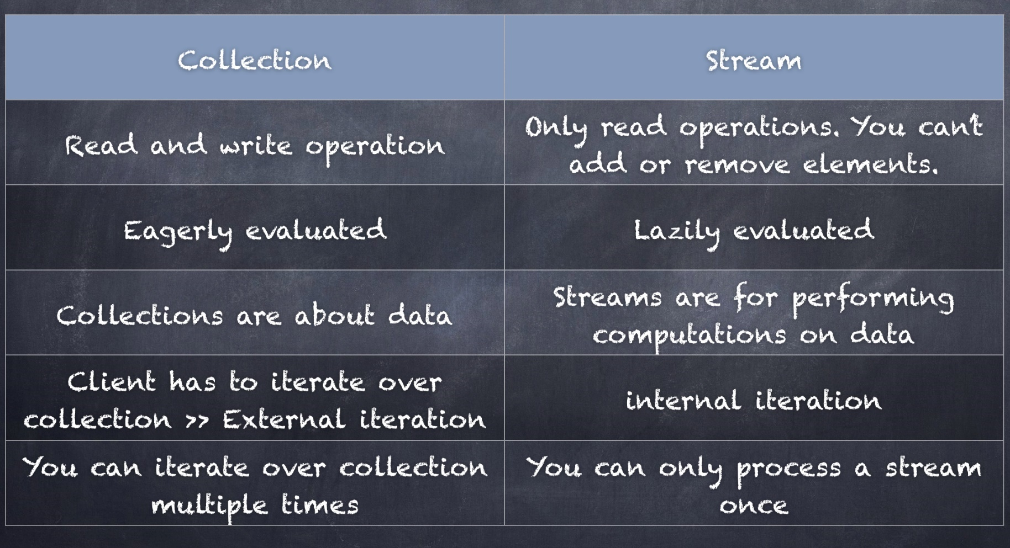
Stream vs Collection
Notes:
Switch to Inteliij to show Lazy evaluation

Slide 37
Avoid Mutation
List<Person> persons = Arrays.asList( new Person("perter", 24), new Person("ian", 30), new Person("jacob", 3), new Person("angela", 28), new Person("mike", 24), new Person("steve", 60), new Person("andy", 30), new Person("jack", 15));
List<Person> sortedPersons = new ArrayList<>(); persons.stream() .sorted((p1, p2) -> (p1.getAge() - p2.getAge() > 0 ? 1 : -1)) .forEach(person -> sortedPersons.add(person));
Notes:
One of the main purposes of lambdas is use in parallel computing – which means that they’re really helpful when it comes to thread-safety.

Slide 38

Mutation Anti Pattern
Banging the head against the wall pattern

Slide 39

Mutation Anti Pattern

Slide 40

Avoid Mutation
List<Person> persons = Arrays.asList( new Person("perter", 24), new Person("ian", 30), new Person("jacob", 3), new Person("angela", 28), new Person("mike", 24), new Person("steve", 60), new Person("andy", 30), new Person("jack", 15));
//immutable sort, good practice List<Person> sortedPersons = persons.stream() .sorted((p1, p2) -> (p1.getAge() - p2.getAge() > 0 ? 1 : -1)) .collect(Collectors.toList());
//immutable sort, good practice Person[] sortedPersons = persons.stream() .sorted((p1, p2) -> (p1.getAge() - p2.getAge() > 0 ? 1 : -1)) .toArray(Person[]::new));

Slide 41
Parallel Programming
Pure Thread Management before Java 5
Thread
Runnable
Synchronized
volatile
Taking advantage of java.util.currency package from Java 5
Executor
ExecutorService
Future
ReentrantLock
Fork/Join framework from Java 7

Slide 42
Parallel Stream
List<Integer> numbers = Arrays.asList(0,4,5,6,2,3,1,8,7,9,56,17,29); // natural sorting numbers.stream() .sorted() .forEach(System.out::println); // natural sorting in parallel numbers.parallelStream() .sorted() .forEach(System.out::println);
Notes:
Then 2 code examples will be followed

Slide 43
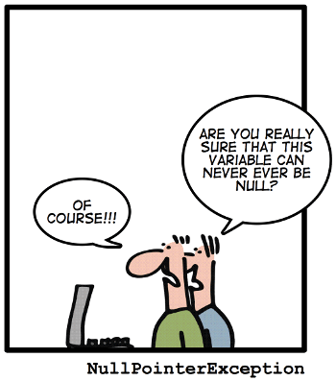
NPE

Slide 44
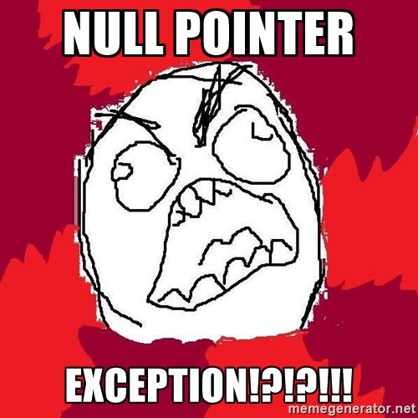
NPE? Annoying

Slide 45

NPE How to deal with it

Slide 46
Optional<T>
A container which may or may not contain a non-null value
Common methods
isPresent() – returns true if value is present
get() – returns value if present
orElse(T other) – returns value if present, or other
ifPresent(Consumer) – runs the lambda if value is present

Slide 47
Optional<T> with Value in it
// Create an instance of Optional Object
Optional<String> optionalGoal = Optional.of("goal");
// Check if there is a value in it System.out.println(optionalGoal.isPresent());
// Get the value
System.out.println(optionalGoal.get());
// If it contains no value, return fallback
System.out.println(optionalGoal.orElse("fallback"));
// Get executed only if there is value in it
optionalGoal.ifPresent((s) -> System.out.println(s.charAt(0)));

Slide 48
Optional<T> with Null
// Create an instance with NULL
Optional<String> optionalNull = Optional.ofNullable(null);
// Returns false since there is no value System.out.println(optionalNull.isPresent());
// Prints fallback since there is no value System.out.println(optionalNull.orElse("fallback"));
// no output, no NPE optionalNull.ifPresent((s) -> System.out.println(s.charAt(0)));

Slide 49
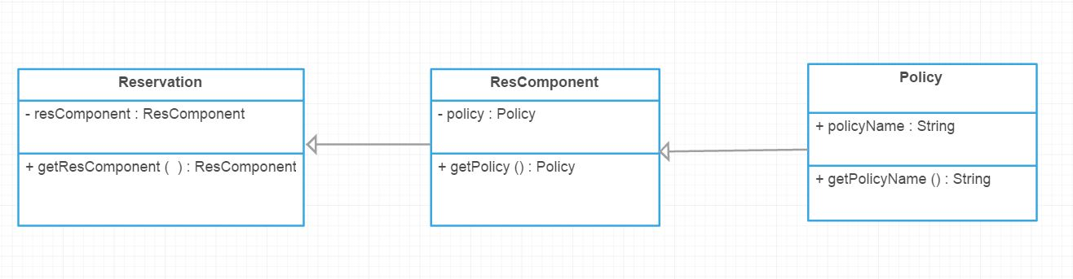
Optional<T> in TDP
Simplified TDP Reservation

Slide 50
Optional<T> in TDP
Get the Policy Name of a Reservation ? Before Java 8
if(reservation != null && reservation.getResComponent() != null && reservation.getResComponent().getPolicy() != null) {
System.out.println(reservation.getResComponent()
.getPolicy()
.getPolicyName());
}

Slide 51
Optional<T> in TDP
Get the Policy Name of a Reservation ? In Java 8
Optional.of(reservation) .map(Reservation::getResComponent) .map(ResComponent::getPolicy) .map(Policy::getPolicyName) .ifPresent(System.out::println);

Slide 52
Optional<T> Benefits
Null checks are not required.
No more NPE at run-time.
We can develop clean and neat APIs.
No more Boiler plate code.
Better readability.
Better maintainability.
Notes:
Some example where real exception needs to be thrown

Slide 53
Real Scenario in TDP
public static ResComponent getPrimaryResComponent(ResComponentGroup resCompGroup, Reservation res) { if (resCompGroup.getGroupMemberCount() > 0) { for (GroupMember groupMember : resCompGroup.getGroupMember()) { if (groupMember.hasPrimaryComponent() && groupMember.hasResComponentSequence()) { ResComponent resComp = ResComponentUtil.getResComponent(res,
groupMember.getResComponentSequence()); if (resComp != null) { return resComp; } } } } return null; }

Slide 54
Real Scenario in TDP
Improved by using λ, Stream and Optional
public static ResComponent getPrimaryResComponent(ResComponentGroup resCompGroup, Reservation res) { return Arrays.stream(resCompGroup.getGroupMember()) .filter(gm -> gm.hasPrimaryComponent() && gm.hasResComponentSequence()) .map(gm -> ResComponentUtil.getResComponent(res, gm.getResComponentSequence())) .findFirst() .orElse(null); }

Slide 55

More Enjoyable!

Slide 56


